Slide 1
Developing an Assessment of Informal Data Science Learning
Two Cycles of Development, Implementation, and Revision Leah Rosenbaum, Joshua Rosenberg, Cody Pritchard, Paulo Blikstein

Slide 2

Welcome and Introduction

Slide 3
Data Learning and Assessment
Learning with data is increasingly prominent in the K-12 curriculum
Many states now have data science education courses and pathways
Assessments are important
Formatively and to understand thinking
Summatively to understand what is (not) working—and how
But, assessments of learning with data remain limited
No widely used assessment
Related instruments (LOCUS) do not seem to fit our ideas or setting
Notes:
Welcome guests, thank for joining, say will share at the end

Slide 4

Background

Slide 5
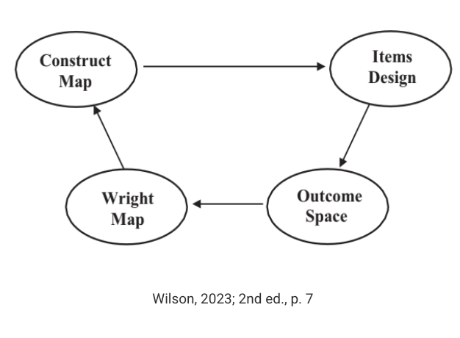
Underlying theoretical frameworks
A cycle of investigative processes (H. Lee et al., 2021)
Lenses (perspectives) on data (V. Lee et al., 2021)
Related statistical concepts (Rubin, 2020)
We We focused especially on two constructs: 1) posing questions and 2) gathering data
Assessment development approach
Construct modeling from Wilson (2023)

Slide 6
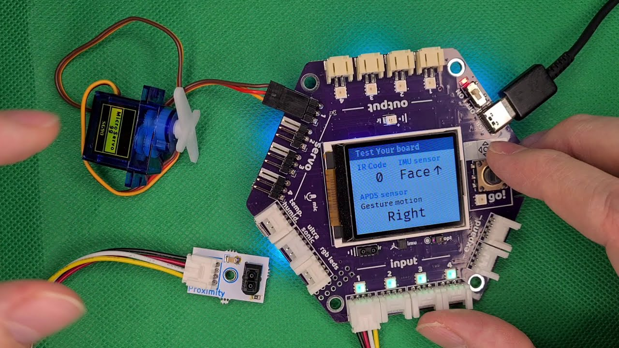
Starting with a construct definition and an elaboration of the construct (in the construct map), we designed items and scored them across the range of the outcome space
Design Considerations
This assessment is for an informal learning context
Week-long camps focused on youth learning to pose and answer questions using programmable sensors, GoGo Boards

Slide 7
Design Considerations
Short Duration: This is for capabilities learners could begint o learn over a week.
Different Items: Asking a variety of questions
Multiple Uses: Potential for both summative and formative use.
Relevance: Ensuring scenarios connect with youth.
Reflection: Designing for potential collective reflection.
Presentation Purposes
Share mid-project progress on our assessment development:
Detail two major development cycles (Version 1 -> Version 2) for one of two constructs: Formulating Questions
Offer insights and resources for others assessing data science learning - And learning in other STEM contexts, especially emerging domains (e.g., AI education)

Slide 8

Findings

Slide 9

Version 1 (Camps 1-3)

Slide 10
Level | Student demonstrated ability
1 | Does not consider any criteria when evaluating a question.
2 | Evaluates a question based on one criterion.
3 | Evaluates a question based on two criteria.
4 | Evaluates a question based on all three criteria.
Construct Definition
Construct Map – Framing Problems
Focal Criteria - Feasibility – time, scope, resources, expertise - Relevance – personal or sociopolitical value - Variability – the answer cannot be found in a reference resource
Coding Map

Slide 11
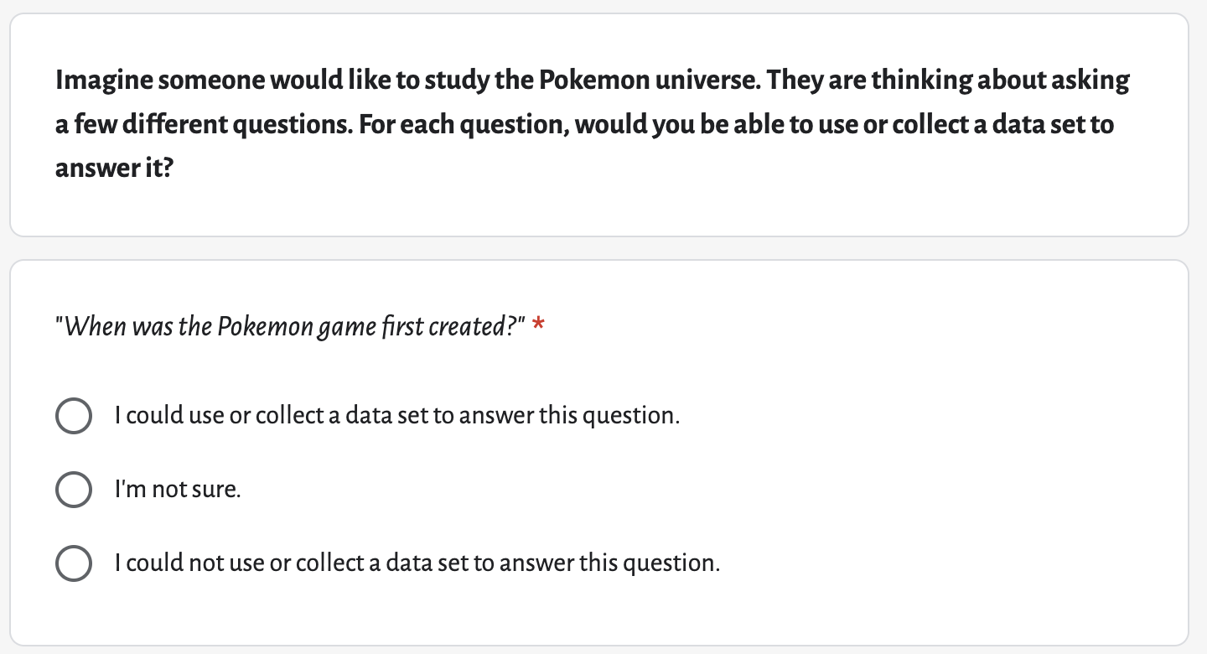
Item

Slide 12
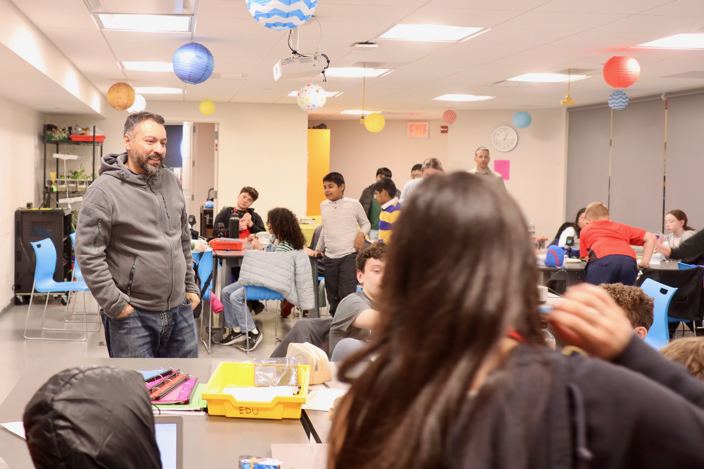
Item details
For each question below, decide whether you could use (or collect) a data set to answer it.
When was the Pokémon game first created?
What do kids learn by playing Pokémon games?
How has the price of the holographic Charizard card changed since it first came out?
Is Pikachu the most popular Pokémon?
If you were going to study the Pokemon universe, what’s a question you could answer by using or collecting a data set? (open-ended)
Takeaways from Version 1
Some change: Some change from beginning to end of camps, but minimal
Expert Review (V2a): Refined construct map and items based on expert feedback.
Revision Rationale: Based on version 1 findings, shifted primarily to open-ended items requiring explanation.
Version 2 (Camp 4)

Slide 13
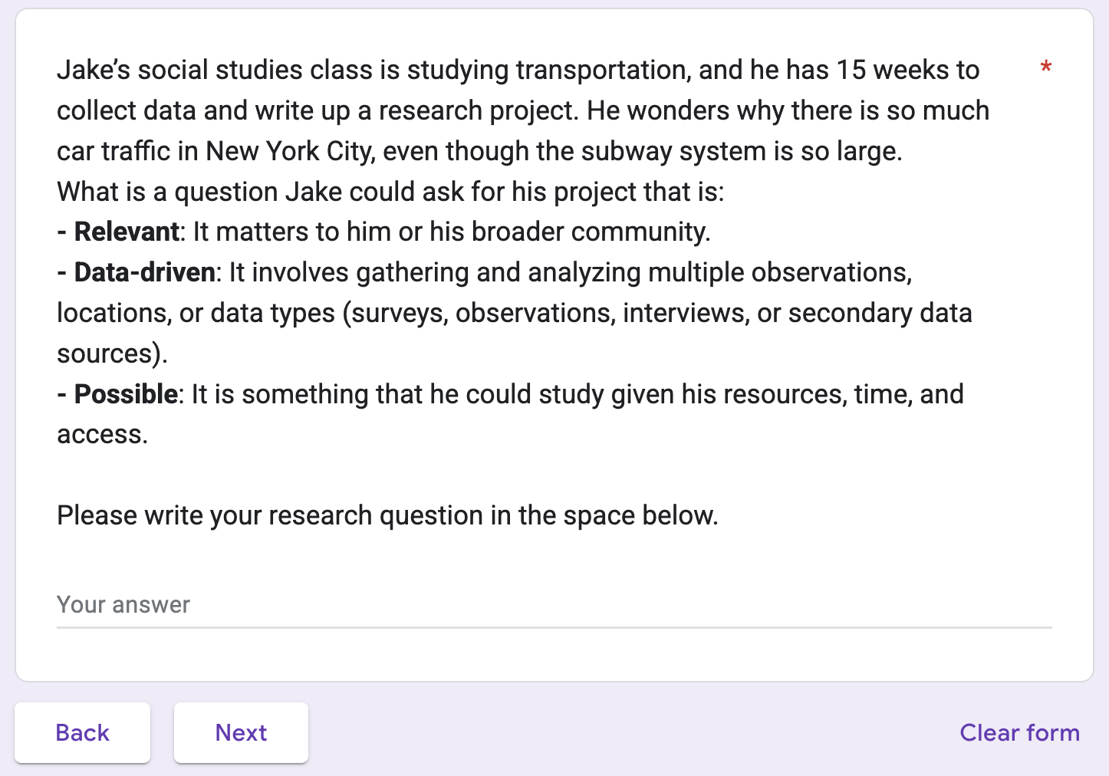
Construct Definition
We consider Formulating Questions to involve three key elements. Students formulate questions exhibiting:
Importance: Concerns personal, professional, or sociopolitical interests.
Data-driven: Involves collecting/analyzing multiple observations/data types to learn about the world.
Feasibility: Demonstrates consideration for time, scope, resources, expertise, access, funding.
Construct Map
Level 0: Non-response or off-topic.
Level 1: Views “data is everywhere”; involves phenomenological/mechanistic questions (“Why do trees fall?”).
Level 2: Question reflects views of data as any number/quantity, including single facts (“How many miles of track?”).
Level 3: Question demonstrates the value of data as repeated measures (“How many people at each stop?”).
Level 4: Question demonstrates the value for modeling/ (“How many people on a typical workday?”).
Item 1

Slide 14
Item 2, Part A
Ava is curious about the safety of students walking to school in her neighborhood. She proposes the question: “How many cars honked at students walking to school today?”
A good research question for Jake should be relevant, data-driven, and possible. Write your research question below:
Is Ava’s question a strong research question based on those criteria?
☐ Yes
☐ No
Item 2, Part B
If you answered “Yes”
Explain why the question “How many cars honked at students walking to school today?” is a strong research question.
If you answered “No”
Explain why the question “How many cars honked at students walking to school today?” is not a strong research question. Then suggest a revised question that is relevant, data‑driven, and possible to help Ava investigate the safety of students walking to school.

Slide 15

Discussion

Slide 16
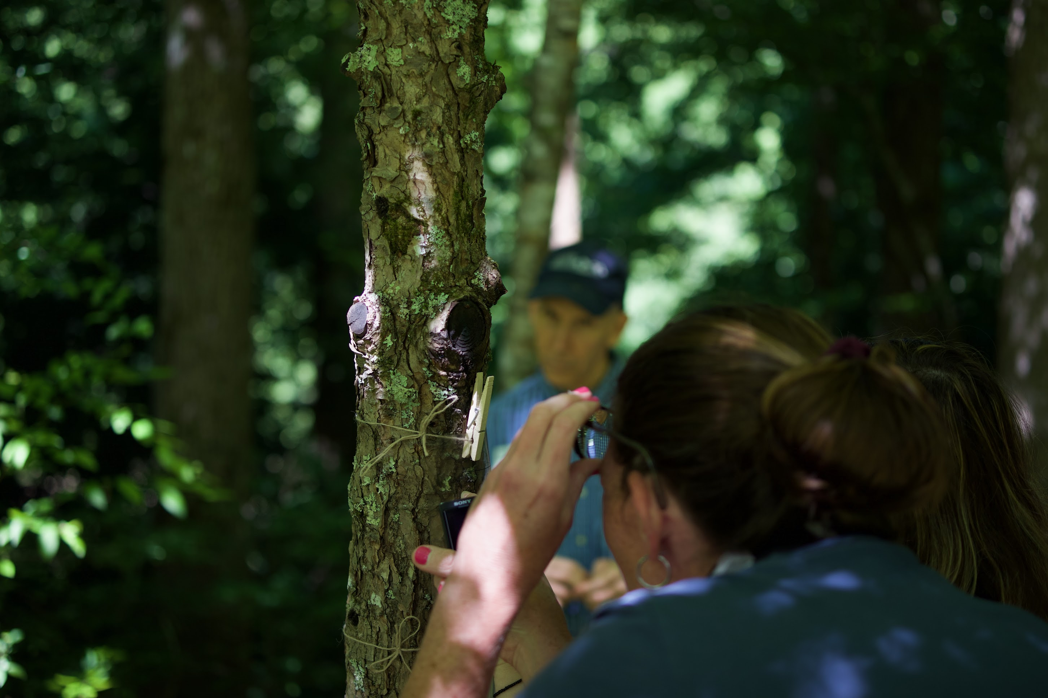
Looking Back: Successes
Collaborative framework (building on Lee et al.) fostered team alignment on focus.
Adhering to the “Constructing Measures” approach provided valuable structure.
Identifying an effective digital platform for administration and data collection.
Successfully balancing assessment design principles with responsiveness to learners and context.
Looking Back: Challenges
Articulating constructs precisely before having rich student response data.
Developing reliable scoring guides for complex open-ended responses (“bootstrapping” the rubric).
Logistics of scoring large numbers (large n) of qualitative responses efficiently.
Determining appropriate rigor (“good enough”) for assessment within dynamic informal contexts.
Looking Forward
Analysis & Validation (V2c): Collect data from ~100-200 participants (camps, MS/HS classrooms). Analyze for construct validity and inter-rater reliability.
Dissemination: Share findings, construct maps, items, process, and validity/reliability evidence via publications, presentations, and open resources.
Efficiency: Explore Machine Learning (ML) to support or automate scoring of open-ended responses.
New Applications: Investigate assessment use for measuring teacher learning in data science
Potential Future Work
Adapt assessment for different informal/formal contexts or age groups.

Slide 17
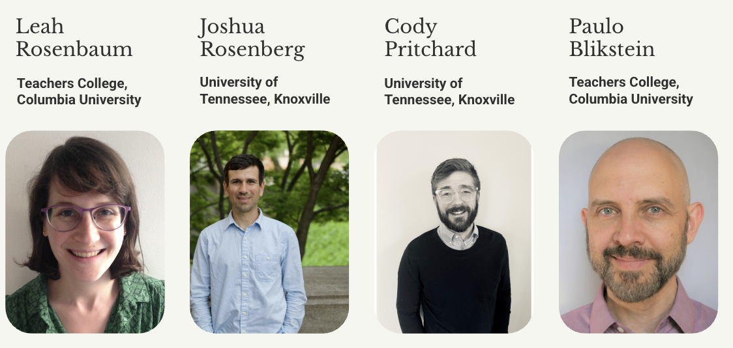
Refine existing items or expand assessment to other data science constructs
Thank you!

Slide 18
Contact: jrosenb8@utk.edu
https://tltlab.org/gogo-board/
Acknowledgments
Thank you to campers and their families! Thank you to the NY Hall of Science team and the other members of this project team for their inputs and contributions to this work.
This material is based upon work supported by the National Science Foundation under Grant No. 2314089. Any opinions, findings, and conclusions or recommendations expressed in this material are those of the author(s) and do not necessarily reflect the views of the National Science Foundation.

